Slide 1
Progress Report: Development of a Visible-NIR Photoluminescence Microspectrometer
Zach Colbert
Department of Physics, OSU
Advisor: Matt Graham
13 November 2018

Slide 2
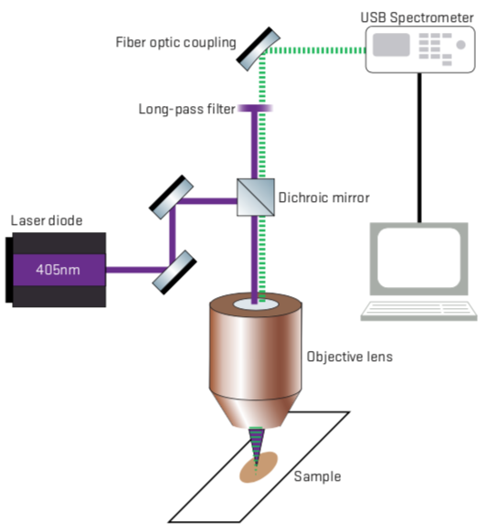
Goals
Couple laser light source into microscope
Couple PL light into Ocean Optics with fiber
Measure visible PL, compare to other data
Couple PL light into InGaAs CCD with grating
Measure NIR PL, compare to other data
Write detailed SOP for taking measurements
(Optional) Measure new materials

Slide 3
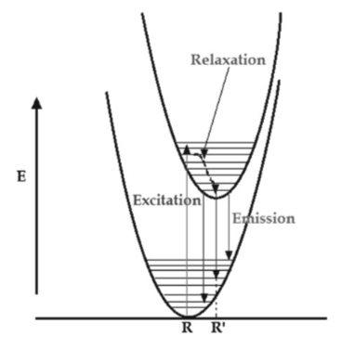
Photoluminescence
Excitation (Single wavelength)
Absorb photon
Electron to “excited state” (“bound state”?)
Relaxation
Lose energy to vibration
Electron to slightly lower “vibronic state”
Shinde, K. N., et al (2012). Basic Mechanisms of Photoluminescence. Phosphate Phosphors for Solid-State Lighting (pp.41-59). Berlin: Springer.

Slide 4
Photoluminescence
Emission (Spectral)
“Radiative relaxation”
Lose energy to photon emission
Electron back to ground state
Measurement
Spectrum of emission
Intensity of emission

Slide 5
Detectors
Not universally sensitive to all wavelengths
Visible Range (400-700 nm)
Si sensors commonly used
Easy application: Ocean Optics spectrometer
Near-Infrared (NIR) Range (800-2500 nm)
InGaAs sensors commonly used
Challenge: Grating, linear CCD

Slide 6
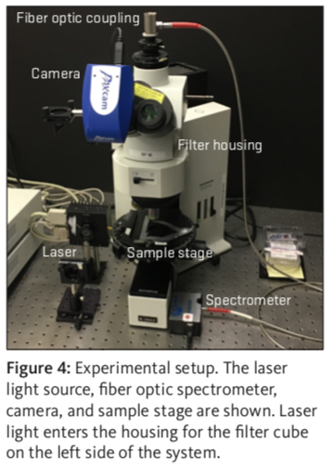
Configuration for Visible PL
Completed summer 2018
Excites with 405nm laser diode
Fiber-coupled Ocean Optics spectrometer
Early results compared to measurements on existing system look good

Slide 7
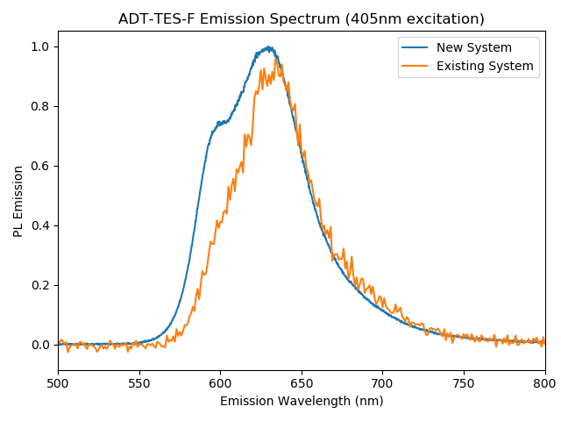
Configuration for Visible PL

Slide 8
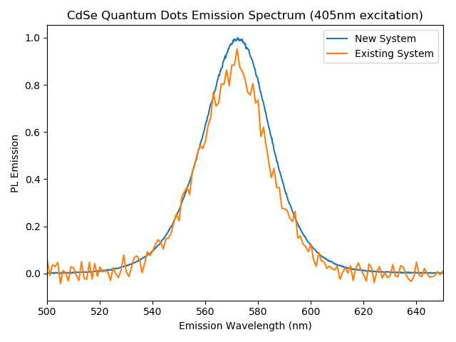
Configuration for Visible PL

Slide 9
Poster

Slide 10
Next Steps
Literature Review – Winter Break
Optics: How do reflective gratings work?
Optics: How to rigorously align light from grating to InGaAs array CCD?
Works using similar systems
Optical Design and Setup – End of Break
NIR Measurements – Winter Break
Comparison and Analysis – Winter Break

